Slide 1
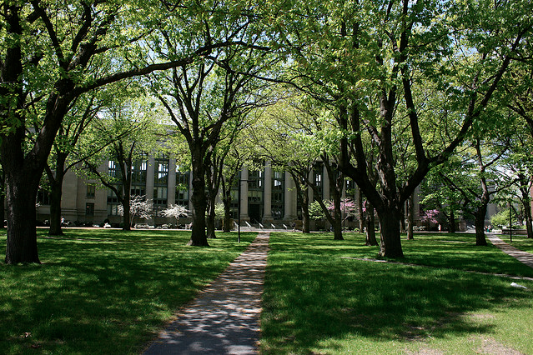
Islamic Finance at Harvard

Slide 2
Islamic Finance at Harvard
More than a Decade of Innovation & Inquiry
S. Nazim Ali, Ph.D.

Slide 3
Outline
Founding of the Islamic Finance Project (IFP) Creation and Guiding Principles of the IFP
Industry & Academia Maintaining Connections Between Industry Professionals & Academia
Research & Development Monitoring & Synthesizing Trends and Development in the Field
Facilitating Productive Criticism Reflecting on Industry Objectives and Progress
Establishing a Think Tank Bringing Industry Professionals, Shari’a Scholars and Economists Together
Sustained Dialogue Creating a Platform for Continued Exchange Among Stakeholders

Slide 4
Founding Principles
To Bridge Industry & Academia
To Promote Research and Development
To Develop the IFP Databank
To Foster an Increased Understanding
To Cultivate Interest in the Field
Notes:
The IFP fosters dialogue and innovation in the field by organizing seminars, workshops, panel discussions, roundtables, and conferences. The Project monitors developments and emerging trends in the Islamic finance industry and invites practitioners to discuss them in the form of seminars and workshops. The structured exchange of ideas between scholars and practitioners at the Harvard Forum and at private IFP workshops enables constructive debate and a longer-term view of the Islamic financial services industry. For industry professionals, it offers a valuable platform to increase awareness of Islamic financial services, to stimulate research and development, and to manage debates about the future direction of the industry.
Another mission of the IFP is to encourage the study of Islamic finance and economics across all of the schools and programs within the University. Because of it’s interdisciplinary nature, the study of Islamic finance brings together faculty from various Harvard departments and faculties. In conjunction with this goal, the IFP produces scholarly monographs and reports, including a compendium of the leading papers brought to its yearly conferences. The IFP produces both print publications and reports available as e-resources via the Project’s website. The IFP works to assist researchers in their scholarly pursuits, including the development of theses, dissertations and other research reports.
The first of its kind, the Databank has filled a niche role, serving as an online tool for the dissemination of bibliographic data in the field. The IFP contacts institutions that engage in Islamic Finance research as well as researchers in the field to advance the acquisition and coordination of information. The Databank’s approach is encyclopedic in scope, while striving to remain accessible to the general readership. In accordance with this mindset, the IFP is continually trying to create a more user-friendly interface in the layout of the Databank. The Databank aims to assist academics, researchers and professionals who require relevant academic information related to Islamic economics and finance and that pertain to shari’a rulings and sources.
As part of its mission, the IFP develops seminars, workshops and panel discussions to encourage faculty and student participation. The Project works with faculty in developing course material relevant to the study of Islamic finance and economics. The IFP works with various faculty members in developing case studies, projects and lectures pertaining to Islamic finance and economics. The IFP has assisted students with their theses and provided career-counseling services for students seeking to forge career paths in Islamic Finance. IFP activities attract students and researchers who often turn to the Islamic finance industry for career opportunities in Islamic financial services.
The IFP has organized seminars and panel discussions to discuss Islamic finance regulation by inviting various regulatory bodies and Islamic finance providers to round tables. These round tables have facilitated better understanding by bridging the gap between industry, academia, and policy. The IFP has worked with the U.S. Treasury, Federal Reserve Bank and other regulatory agencies to facilitate a better understanding Islamic finance. Through its public lectures, newsletters, and other publications, the IFP seeks to disseminate information and create understanding of Islamic finance and economics.

Slide 5
Facilitating Productive Criticism
Collaborative Research & Industry-Building The IFP as a Critical Component of the Field
Assessing New Products & Services Providing Feedback on Innovation
Original Academic Research Offering New Perspectives on Central Concerns
Facilitating Criticism & Reflection Evaluating the Field
Notes:
The IFP has taken a proactive role in collaborative research and industry-building efforts with other institutions. By educating regulators and connecting them to Islamic financial institutions, bringing together senior shari’a scholars and Muslim economists for constructive engagement on critical issues, and by co-sponsoring events with other universities, the IFP has sought to bring diverse constituencies and institutions closer together in the interest of the industry. One of the IFP’s greatest assets has been the involvement and support it enjoys from individuals in the Islamic finance industry. The Project has further interacted with the Islamic finance community through its involvement with specific research projects, seminars, committee representations, the IFP Endowment drive, other IFP fundraising events, and the industry recruitment of Harvard students.
The Project maintains a balance between academic and industry-related interactions. Its links with the financial world have also increased the number of financial resources available to the Project. The IFP’s position in the academic community has allowed the Project to participate in the creation of new products and services in the Islamic finance industry, while providing the industry with original academic research.
In addition, the Project has provided a unique opportunity to compare the current realities of the Islamic finance industry with founding principles or objectives. The Project has facilitated discussions on various contentious topics in the field including Shari’a compliance, product development and social responsibility especially in the context of microfinance.

Slide 6
Establishing a Think Tank
Harvard University Forum on Islamic Finance A Biannual Opportunity to Bring Industry Professionals Together
Notable Past Forums:
Global Market (1997) The Twenty-First Century (1998) Local Challenges & Global Opportunities (1999) The Task Ahead (2000) Dynamics & Development (2002) Current Legal Issues (2004) Standardization & Transparency (2006) Innovation & Authenticity (2008) Building Bridges Across Financial Communities (2010) Islamic Finance & Development (2012)
Notes:
The IFP has regularly organized and hosted the Harvard University Forum on Islamic Finance since 1997. It is unique among industry conferences for its academic perspective and its ability to bring together practitioners, academics and shari’a scholars in order to discuss and debate the direction of the industry.
The Harvard Forum grew during its ten conferences from a small one-day affair to a major multi-session international conference that brings together the latest research in academia, contemporary developments in the industry, and leading analyses by academics and government officials. As it has become more established, the Forum has also fostered a sense of community among researchers while promoting healthy debate and collaboration between academics, practitioners, and institutions.
The Harvard Forum serves as a magnet for all types of individuals in the field of Islamic finance. Among the many attendees, bankers, economists, shari’a scholars, financial analysts, attorneys, legal practitioners, management professionals, professors and students have all participated in past forums. On average, more than two hundred people have attended each conference, with many others following the program electronically and/or purchasing the proceedings.
The Forums, with their comprehensive approach to exploring the ideals, practice, and prospects of the industry, monitor the development of Islamic Finance while analyzing trends and future opportunities. THe presentations have dealt with shari’a perspectives, investments and financial products, new opportunities and directions, and other aspects of economics, finance, and development. Forums have provided a broad range of resources including introductory programs for newcomers and discussions of sensitive and critical issues such as Islamic jurisprudence, governmental regulation, product development, and ethics.
The IFP has remained committed to keeping the Forums as accessible as possible. The Forum has reduced registration fees for those with limited funds. A free and public presentation entitled “Workshop on Islamic Finance for Newcomers” was also made available at the Fourth and Fifth Forums. The sessions aimed to introduce Islamic Finance to those who had little or no prior exposure to the field. Beyond members of the Harvard community, other students and members of the Boston-area community have also been a significant presence at each Forum.
The Forum is also unique in devoting at least one entire session to shari’a or Islamic law. Every year, jurists in fiqh al-mu’amalat (the branch of Islamic law dealing with economic and financial matters) have addressed the Forum audience and presented papers. Other sessions have covered Islamic economics, Islamic Finance, and the practices of Islamic Finance by financial institutions.

Slide 7
Establishing a Think Tank
Harvard-London School of Economics Workshops Specialized Meetings on Policy and Service Products
Notable Past Workshops:
Tawarruq (2007)
Sukuk (2008)
Risk Management (2009)
Governance (2010)
Industry Reappraisal (2011)
Value Proposition (2012)
Other Institutions
Maintaining Ties with Conventional Institutions
Notes:
The IFP, in partnership with the London School of Economics (LSE), has been organizing specialized workshops and public lectures on methodological issues confronting the Islamic finance industry on a yearly basis since 2007. The principal impetus for these workshops is to fill the conversational void between two of the professional groups integral to the evolution of Islamic Finance: shari’a scholars and Islamic economists. The workshops also bring other partners, legal experts, regulators and industry leaders who are involved in day-to-day operations. Six workshops have been held in the past on a variety of issues.
The IFP has remained in contact with most Western institutions involved in research on Islamic Finance. These have included departments and programs within formal academic institutions, research and legal advisory departments of commercial financial institutions, and non-governmental organizations (NGOs) such as the Islamic Development Bank, Organization of Islamic Corporation (OIC), Accounting & Auditing Organization for Islamic Financial Institutions (AAOIFI), the Islamic Finance Services Board (IFSB), the International Islamic Financial Market (IIFM), the International Monetary Fund (IMF) and the World Bank. The IFP has sought to assemble the various research bodies and information service providers within the Islamic Finance community at the International Research Roundtable in an effort to increase coordination, avoid duplication, and enhance the efficiency and synergy of the sector’s research and development.

Slide 8
Sustained Dialogue
Public Lectures Involving Public Stakeholders
Press Services Informing Major Media Outlets
Relations with Regulatory Institutions Facilitating Dialogue Between Regulators and Industry Professionals
Notes:
The IFP, in partnership with the London School of Economics (LSE), organizes workshops and public lectures on methodological issues confronting the Islamic finance industry on a yearly basis. The principal impetus for these workshops is to fill the conversational void between two of the professional groups integral to the evolution of Islamic Finance: shari’a scholars and Islamic economists. The workshops also bring other partners, legal experts, regulators and industry leaders who are involved in day-to-day operations. Six workshops have been held in the past on a variety of issues including: Islamic Financial Intermediation: Revisiting the Value Proposition Workshop (2012); Reappraising the Islamic financial sector (2011); Islamic financial ethics and ethical governance (2010); the Evolution of the Global Financial System from the Current Crisis (2009); Microfinance: Toward a Sustainable Islamic Finance Model (2008); Sukuk: Economic and Jurisprudential Perspectives (2008); and TAWARRUQ: A Methodological Issue in Shari’a-Compliant Finance (2007). Details of these workshops may also be found online at the IFP Website.
The IFP has provided information on Islamic finance to the press, resolving misconceptions and raising awareness of developments in the industry. Media outlets with which the IFP has had contact with over the years include Fortune, Gulf Daily News, Islamic Banker, National Public Radio (NPR), and the Wall Street Journal.
The Project has worked to bridge the gap between institutions and governmental regulatory bodies by encouraging their engagement in the Islamic finance industry through various seminars and workshops. The Project has answered inquiries relating to Islamic Finance from the U.S. Treasury, and has in the past conducted two seminars at the Treasury for its staff, members of the executive branch, and Congressional staff. United States Treasury Undersecretary, John Taylor, was the keynote speaker of the Sixth Harvard University Forum on Islamic Finance in 2004 on “Understanding and Supporting Islamic Finance: Product Differentiation and International Standards.”
The IFP has also hosted a workshop on the Supervision and Regulation of Islamic Financial Institutions in the United States which was held on March 19, 2005 at the Harvard Law School. This workshop was key in placing Islamic financial institutions face to face with relevant U.S. regulators. The purpose of this seminar was to initiate discussions between Islamic financial institutions and regulators about the current and future supervision and regulation of the Islamic Finance industry in the United States. There were over forty representatives present from various government agencies such as the Securities and Exchange Commission (SEC), the Federal Deposit Insurance Corporation (FDIC), the Federal Reserve Board (FRB), and the Office of the Comptroller of the Currency (OCC), along with almost all institutions providing Islamic finance products and services in the U.S. and abroad.
The IFP has also worked with the Federal Reserve Bank of New York (FRBN) to organize an interagency forum on Islamic Banking in the United States in 2006. The purpose of this meeting was to advance the discussion of regulatory issues relating to Islamic banking. The IFP has also invited governors of several central banks to its biennial events to discuss relevant issues and regional advancement.

Slide 9
Research & Development
The IFP Project Website An Open Access Resource
The IFP Databank A One-stop-shop, Interdisciplinary Resource
Islamic Investment Study Harvard’s First Foray into Islamic Finance Academic Inquiry
Forum Proceedings & Event Publications Establishing the Literature of the Field
Notes:
Academic research often involves the dual task of data collection and systematic analysis. The Islamic Finance Project has sought to further research in Islamic Finance, Islamic economics, and related shari’a issues at both ends of this process. The IFP’s first major undertaking at Harvard was the development of the IFP DataBank, the then most comprehensive database of the Islamic financial services industry. The IFP continues to manage and develop the Publications, shari’a and Glossary components of this database. The IFP Databank is now available on the Project website. Over 10,000 original records can be accessed free of charge by researchers around the world (and of course here on campus!).
In the field of Islamic finance and investment, information is scattered across various sources and is not always easily accessible. In fact, information is largely unavailable to most researchers because it originates from primary contacts in the industry and is published privately or obscurely. Created in 1995, the Databank attempts to diminish these difficulties. In the seventeen years of its existence, the IFP Databank has become a well-established research tool and the largest source of information available to researchers worldwide on all aspects of Islamic finance.
A large portion of IFP activity centers on the compilation, maintenance, and technical development of the IFP Databank. Information in the Databank is collected continuously by Harvard students who obtain primary and secondary sources of information on the field by scouring libraries, published government materials, Internet sources, and the two hundred institutions in the Islamic financial field with which the IFP maintain contacts.
The IFP website (http://ifp.law.harvard.edu) is kept up-to-date with event notices and announcements. The website has been expanded to include summaries of and reports from important events such as the biannual Harvard University Forum on Islamic Finance, annual workshops, and specialized seminars, which can be downloaded from the website. The IFP is also in the process of providing access to full papers published from previous Forums.
The Islamic Investment Study began in 1993 and culminated in the publication of Islamic Finance: Religion, Risk and Return by Frank Vogel and Samuel Hayes. This study was sponsored by several financial institutions including the National Commercial Bank (Saudi Arabia), the Islamic Development Bank (Saudi Arabia), Wellington Management Company (Boston), and Goldman Sachs (London). The study indicated increasing interest at Harvard in Islamic finance.
In September 1999, the IFP published the proceedings of the Second Harvard University Forum on Islamic Finance, a landmark publication with over thirty original works covering Islamic economics, shari’a, Islamic finance, commercial products, and business models. The compilation of the proceedings was the work of IFP research associates, mostly students from Harvard University and especially among the undergraduates of Harvard College. This volume held the distinction of being the first complete proceedings of a conference on Islamic finance. Today, the IFP regularly publishes the proceedings of the Forum, adding scholarly introductions and an extensive index to the papers presented. Each volume has highlighted some of the most important developments in the field and served as a valuable resource for industry leaders as well as scholars.

Slide 10
Research & Development
Harvard Community Support Involvement with Harvard Business, Law, Kennedy and Divinity Schools Islamic Finance at the Faculty of Arts & Sciences
Specialized courses on Islamic Finance & Law Forging the Academic Path for Future Professionals
Theses & Dissertations Support for Student Research Endeavors
Notes:
Although the Project has never played a formal role in Harvard University’s curriculum, it has assisted individual faculty members at the Faculty of Arts and Sciences, Law, Business, and the Kennedy Schools with their research and teaching on an ad hoc basis. Faculty and students have used the Project’s resources for their own research. The Project has also provided information access, informal advice, and guidance on thesis research to students from the Law and Business Schools and the Departments of Economics, Government, and History.
The Law School in particular has extended considerable support to the IFP. Under the auspices of the Islamic Legal Studies Program (ILSP), the IFP has hosted fellows on a yearly basis who have consistently found the IFP to be a great resource in their research. In addition, the Law School has offered courses in Islamic contracts since 1995 and, more recently, a full-fledged seminar course on Islamic Finance Regulation. A number of students have completed research papers and theses on Islamic finance related fields and have been supervised by senior Law School professors.
At the Business School, several faculty members have taken part in the biennial Islamic Finance Forum, especially Samuel L. Hayes, III, Professor Emeritus. Several seminars have been sponsored and organized by the Business School Islamic Club on Islamic finance as a subject of academic interest and a field offering a number of career opportunities for MBA students.
Students at the Harvard Kennedy School have shown an interest in the IFP, especially with regard to policy, regulation, political economy and socially conscious investment. In the past, students have utilized the IFP for research on relevant public policy and governance issues.
At the Divinity School, a number of students and faculty members have had an interest in social, ethical, and faith-based investment.
At the Faculty of Arts and Sciences, students from the Center for Middle Eastern Studies (CMES) and Near Eastern Languages and Civilizations, Economics, and Government Departments have found IFP resources to be helpful for their research.
While no official degree or certification programs for Islamic financial studies are currently available at Harvard, the Harvard Law School (HLS) continues to offer a number of relevant courses. HLS has been on the cutting-edge of Islamic Finance research and teaching with a tradition of inquiry in the field spanning over a decade. The first course to mark this interest in Islamic Finance at Harvard was offered in 1996 under the guidance of Professor Frank Vogel. The following courses have been offered throughout the years: Regulation of Islamic Finance; Islamic Contract Law; Introduction to Islamic Law; Comparative Law: The Islamic Legal System; Contemporary Islamic Legal Though: Law, State, and World Order; Concept of Obligation in Islamic Law; Fatwas and Muftis; and Topics in Islamic Law.
The most recent addition to the list of courses offered at HLS has been Regulation of Islamic Finance, a seminar course focusing on the role of Islamic Finance in the financial markets of nearly every country. In the first few weeks of the seminar, the course focuses on the Islamic legal rules at the heart of Islamic finance to understand how the twin prohibitions of riba (often translated as interest) and excessive risk serve as the foundation of the industry. After learning these basics, the course studies the contribution of Islamic finance to major markets worldwide, including in the U.S., England, France, and countries in the Middle East and Asia. The in-depth country-by-country approach of the course considers the details of each market, including the volume and types of products, the players on the demand and supply side, and the regulatory framework. It also examines international Islamic finance standard-setting and regulatory bodies, as well as the crucial role of shari’a scholars.
Further, HLS spearheaded efforts to offer seminars taught by visiting professors. Among the many classes available, a course on synthetic transactions was offered at Harvard Law School by Shaykh Nizami, Dars fi-Nawazil Fiqh al-Mu’amalat. The course focused on issues surrounding the legality of synthesizing financial transactions that have been debated by Muslim jurists throughout the history of Islamic law.
At the Harvard Business School, a seminar course was offered on the Principle of Islamic Finance. In this seminar, students were introduced to the theory and practice of Islamic finance, and the set of financial concepts, solutions and service providers that conform to the principles of Islamic financial ethics. Through discussions of the key concepts, techniques and institutions in the field as well as analysis of case studies of several important entities and transactions in the Islamic finance sector, students were able to acquire a sound foundation of the field.
In conjunction with various Harvard institutions, the IFP has also contributed to the development of Islamic Finance curricula at other institutions of higher learning. At the Faculty of Arts and Sciences relevant courses offered in past years include: Ottoman Legal History, Islamic Legal Theory, Studies in Islamic Law: Early Sunni Legal Doctrine, Texts in Islamic Theology and Law, and Readings in Modernist Islamic Law.
Several students at Harvard Law School have written their doctoral dissertations on topics related to Islamic Finance and the Project continues to lend its resources and support to students wishing to write future theses or dissertations about the field.

Slide 11
List of Theses
Corporate governance in Islamic finance, promises (LLM Thesis, Harvard Law School), 2011)
Essays on faith and finance (D.B.A. Thesis, Harvard Business School), 2010)
Islamic banking and the financial crisis. (B.A. Hons Thesis, Harvard College), 2010)
Mudaraba as a mode of Islamic finance (LLM Thesis, Harvard Law School), 2010.
From radical Islam to "smoke and mirrors": the trajectory of Islamic finance (B.A. College Thesis), 2008.
International petroleum contracts. (S.J.D Thesis, Harvard Law School, 2008)
The rules of Îamån and the contemporary practice of Islamic finance (S.J.D. Thesis, Law School 2007)
Economic integration and cultural resistance: Islamic finance in the Arab Gulf (Ph.D. Thesis, 2004)
Islamic banking, risk analysis and the impact of Basel II on its future (LLM Thesis, 2004)
Islamic banking in Lebanon: remarks (LLM Thesis, Harvard Law School 2004)
Western banking practices and shari'a law in Saudi Arabia (LLM Thesis, Harvard Law School, 1992
Notes:
Harvard’s first foray in the field of Islamic financial services was the Islamic Investment Study, which concluded with the 1998 publication of Islamic Law and Finance: Religion, Risk and Return by Harvard professors Frank E. Vogel and Samuel Hayes III. The university’s most significant investment in this area, however, has been the longstanding Islamic Finance Project (IFP), a research program that emerged in from the growing interest in Islamic Finance among members of the Harvard community in the mid-1990s.
The Islamic Finance Project (IFP) was founded by the Harvard University Center for Middle Eastern Studies (CMES) in 1995. The IFP became part of the Islamic Legal Studies Program (ILSP) at Harvard Law School in 2003. As the only Ivy League project of its kind, the IFP studies the field of Islamic Finance from a legal perspective by analyzing contemporary scholarship, encouraging collaboration among scholars within and outside the Muslim world, and increasing the interaction between theory and practice in the Islamic Finance industry.

Slide 12
Harvard Business School Case Studies
Aluminium Bahrain (Alba): The Pot Line 5 Expansion Project (TN) / Benjamin C. Esty and Aldo Sesia. Harvard Business School Teaching Note, 2004.
Aluminium Bahrain (Alba): The Pot Line 5 Expansion Project (CW). / Esty, Benjamin C., and Aldo Sesia. Harvard Business School Spreadsheet Supplement 205-708, 2004.
Aluminium Bahrain (ALBA): The Pot Line 5 Expansion Project./ Benjamin C. Esty, and Aldo Sesia. Harvard Business School Case 205-027, 2004.
International Investor: Islamic Finance and the Equate Project / Benjamin C. Esty, and Mathew M Millett. Harvard Business School Case 200-012, 1999.
International Investor, Islamic Finance and the Equate Project TN. / Benjamin C. Esty and Mathew M Millett. Harvard Business School Teaching Note 200-013, 1999.
An Introduction to Islamic Finance / Benjamin C. Esty, Mathew M Millett, and Fuaad Qureshi. Harvard Business School Note 200-002, 1999.
Notes:
Harvard’s first foray in the field of Islamic financial services was the Islamic Investment Study, which concluded with the 1998 publication of Islamic Law and Finance: Religion, Risk and Return by Harvard professors Frank E. Vogel and Samuel Hayes III. The university’s most significant investment in this area, however, has been the longstanding Islamic Finance Project (IFP), a research program that emerged in from the growing interest in Islamic Finance among members of the Harvard community in the mid-1990s.
The Islamic Finance Project (IFP) was founded by the Harvard University Center for Middle Eastern Studies (CMES) in 1995. The IFP became part of the Islamic Legal Studies Program (ILSP) at Harvard Law School in 2003. As the only Ivy League project of its kind, the IFP studies the field of Islamic Finance from a legal perspective by analyzing contemporary scholarship, encouraging collaboration among scholars within and outside the Muslim world, and increasing the interaction between theory and practice in the Islamic Finance industry.

Slide 13
Articles and Papers Published in Harvard Magazines
Islamic Finance: The New Global Player. Harvard Business Review, February 2008, pp. 43
Christanto, Rika, Shari'ah Finance: investment inside the Islamic world. Harvard College Investment Magazine, Summer, 2006, pp. 45-47
Risk Mitigation at Hubco: Conventional vs Islamic Finance Contracts / Chirag Vasawada (Unpublished course paper, Harvard Business School, 2001.
Wright, P. Doing business in Islamic markets. Harvard Business Review, January/February, 1981, pp.34
Notes:
Harvard’s first foray in the field of Islamic financial services was the Islamic Investment Study, which concluded with the 1998 publication of Islamic Law and Finance: Religion, Risk and Return by Harvard professors Frank E. Vogel and Samuel Hayes III. The university’s most significant investment in this area, however, has been the longstanding Islamic Finance Project (IFP), a research program that emerged in from the growing interest in Islamic Finance among members of the Harvard community in the mid-1990s.
The Islamic Finance Project (IFP) was founded by the Harvard University Center for Middle Eastern Studies (CMES) in 1995. The IFP became part of the Islamic Legal Studies Program (ILSP) at Harvard Law School in 2003. As the only Ivy League project of its kind, the IFP studies the field of Islamic Finance from a legal perspective by analyzing contemporary scholarship, encouraging collaboration among scholars within and outside the Muslim world, and increasing the interaction between theory and practice in the Islamic Finance industry.

Slide 14
Investing in the Network
Visiting Research Scholars Program Fostering International Ties
Internships Offering the Next Generation Opportunities Abroad
Friends of the IFP Creating an Inclusive and Expanding Network
Notes:
The IFP supports research in Islamic banking and finance by providing visiting scholars access to Harvard University’s vast resources, which include dozens of libraries, hundreds of periodicals, and millions of books. The Visiting Research Scholars Program invites prominent researchers in the field to Harvard under the IFP’s auspices and provides them with the opportunity to complete their research. The IFP’s first visiting scholar was Muhammed-Shahid Ebrahim, presently of Nottingham University. While at the IFP during the summer of 1997, he published two papers on financial engineering in Islamic finance. As a visiting scholar at the Islamic Legal Studies Program in 1998, Gohar Bilal also conducted research at the IFP and helped organize the Second Harvard University Forum on Islamic Finance. She analyzed Islamic tradable instruments and published an article entitled “Islamic Finance: Alternatives to the Western Model” in Fletcher Forum of World Affairs. Finally, in 2001, Omar Kamal was a visiting researcher at the IFP while writing his doctoral dissertation.

Slide 15
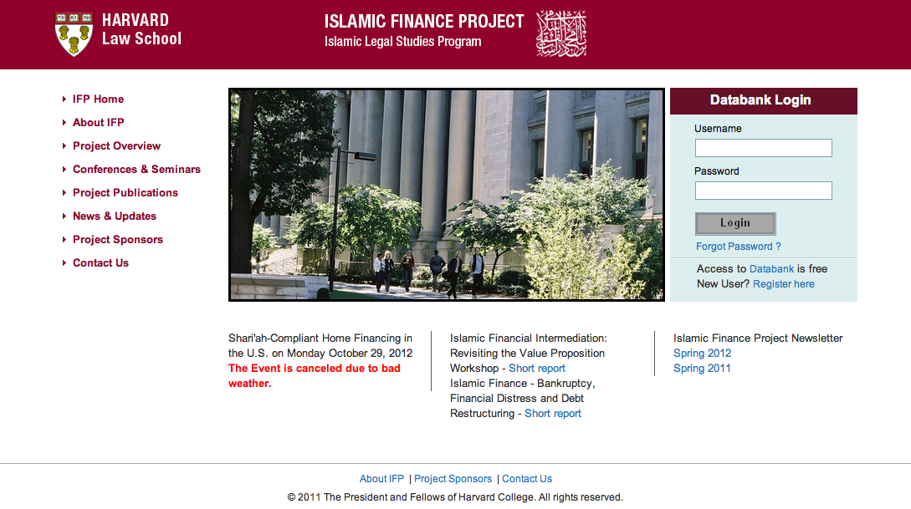

Slide 16
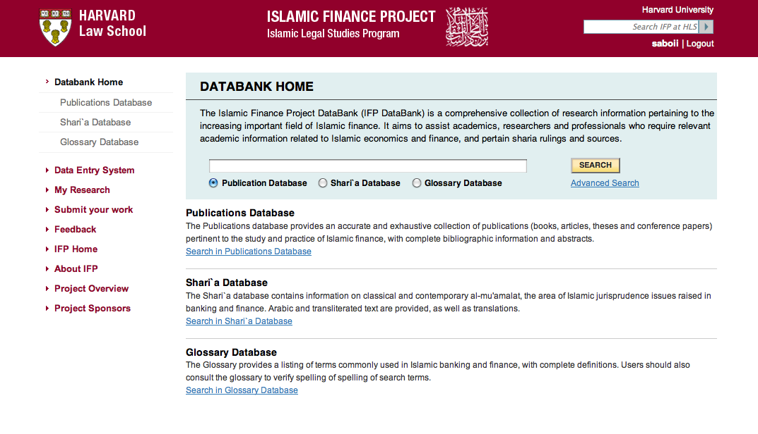

Slide 17
Disclaimer
These slides are the views and research of the author's alone and do not represent those of Harvard University or Harvard Law School. "

Slide 18
